Slide 1
Micah ppc opportunities
An in depth perspective on all ppc activity.

Slide 2
Let’s start with an overview of your ppc for your specific locations
We’ll cover lexus of pembroke pines and lexus of north miami beach as our focal points in this presentation.
Let’s start with lexus of pembroke pines.

Slide 3
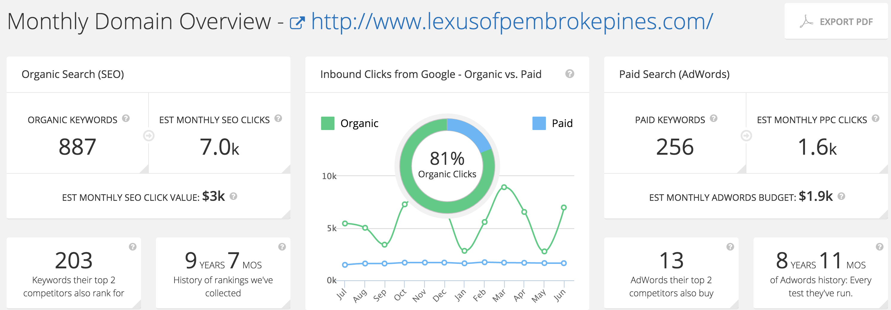
Here is an overview of the traffic breakdown for your domain. 19% of the traffic to this sites location comes from PPC. The other 81% comes from SEO or other traffic mediums.
Very consistent PPC traffic! Great job maintaining a solid performance.

Slide 4
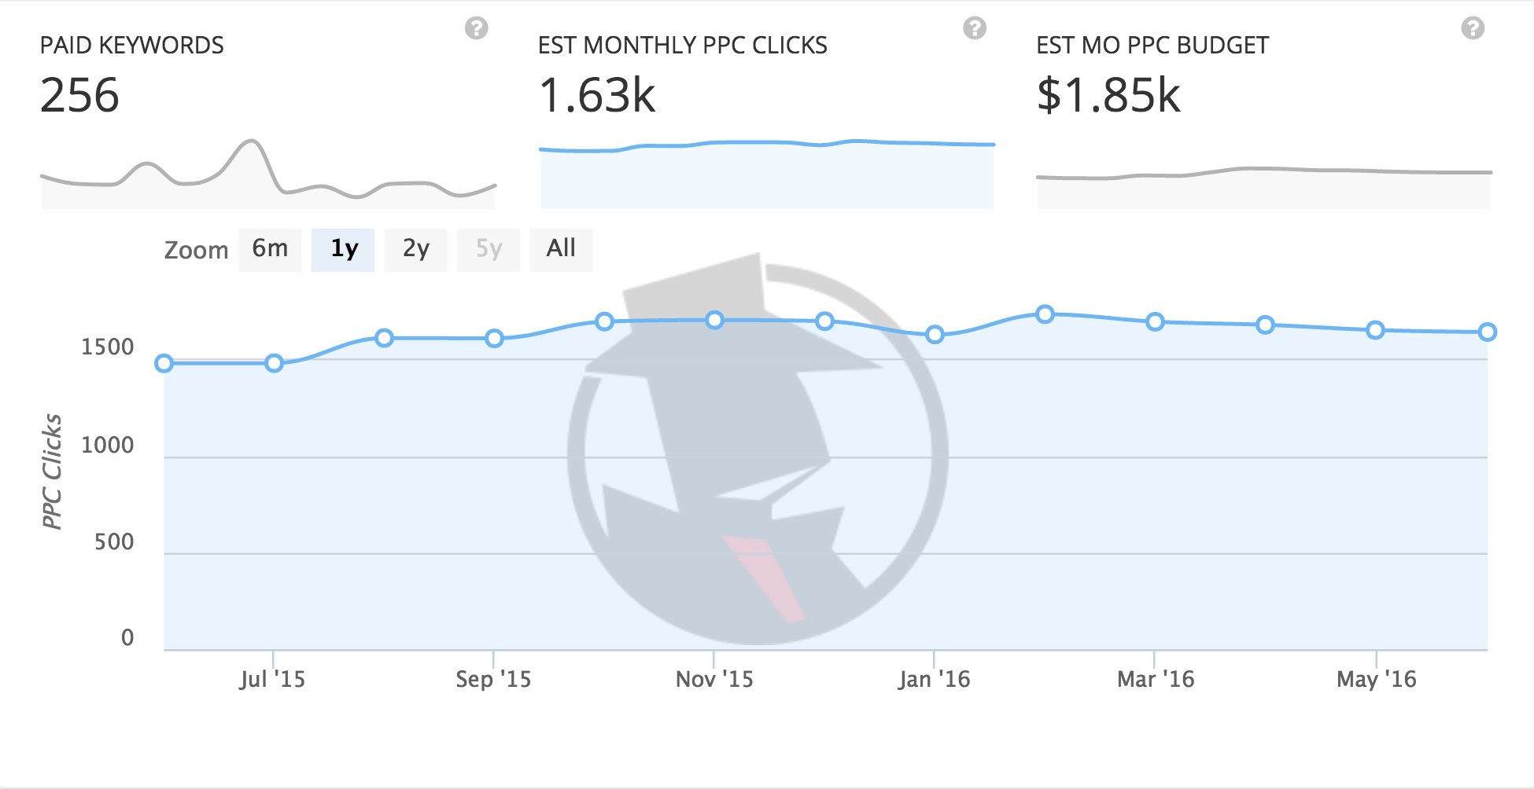
Here is a breakdown of your PPC traffic for the last year or so.

Slide 5
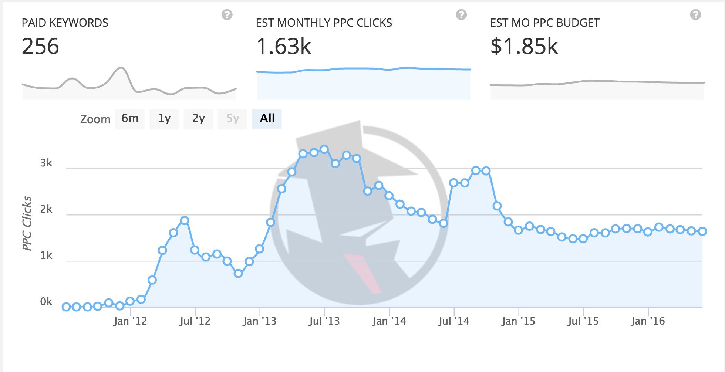
Here is the PPC data for the history of the adwords account.

Slide 6
Let’s look at another locations PPC traffic
We’re going to transition into looking at the PPC overview for lexus of north miami.
We will then look at these locations vs competitors.

Slide 7
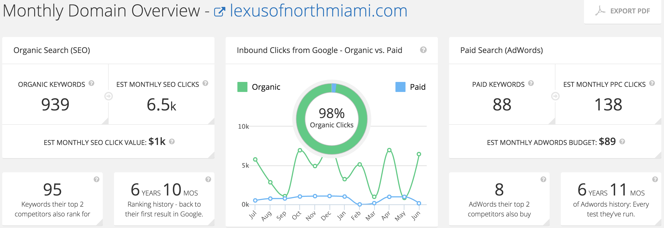
Here is an overview of the traffic breakdown for your domain. Here only 2% of your website traffic comes from PPC.
98% of your website traffic has come from SEO or other organic mediums!
Very sporadic results for SEO depending on the time of year certain keywords gain more traction over others.

Slide 8
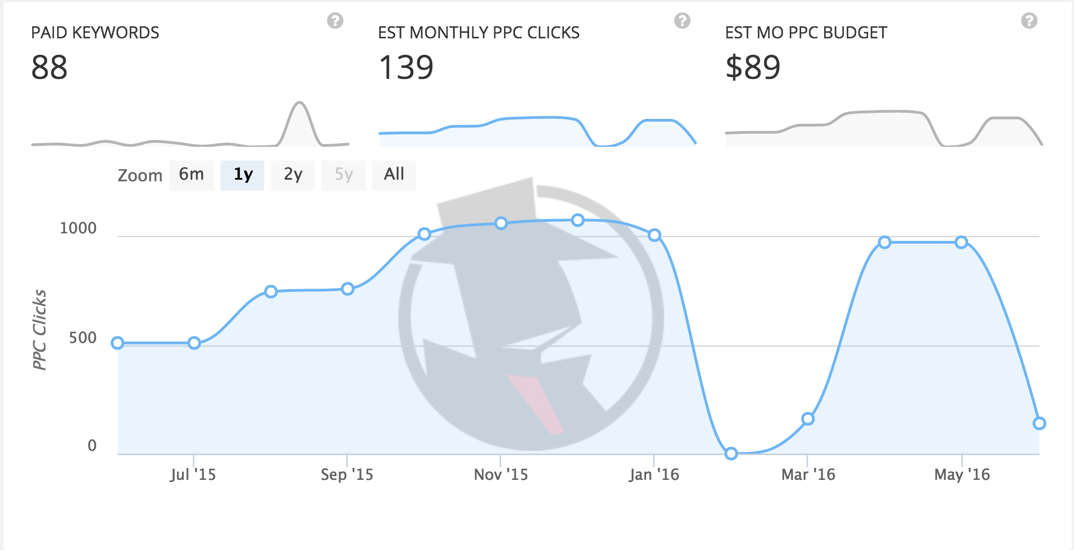
Here is a breakdown of your PPC traffic for the last year or so. Small dip in budget after Lexus’s December to remember event?

Slide 9
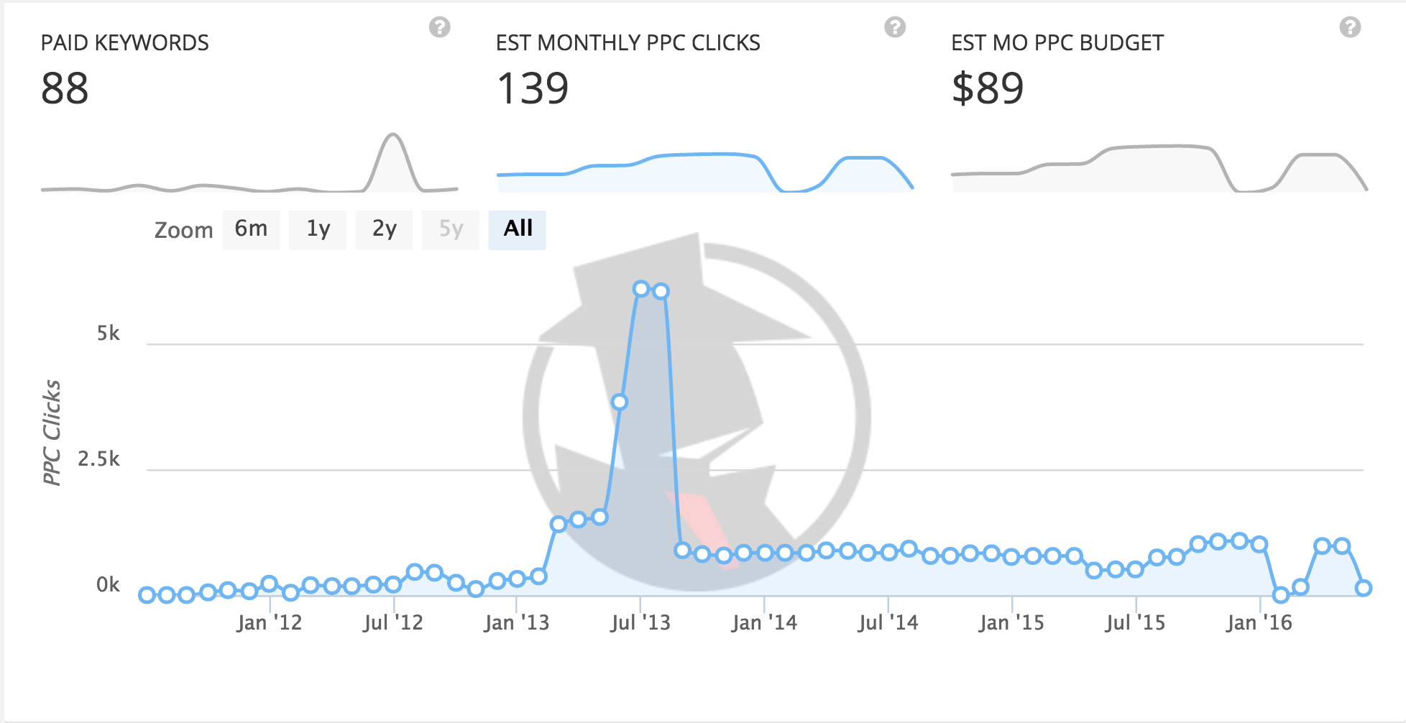
Here is the PPC data for the history of the adwords account.

Slide 10
Let’s take a look at you vs your competitors (including other locations owned and operated by you)
We’re going to compare the pembroke pines location to several key competitors and competitors you have historically mentioned.
We’ll start with looking at the amount of keywords being used, then the traffic from the keywords being used followed up by the advertising budgets.

Slide 11
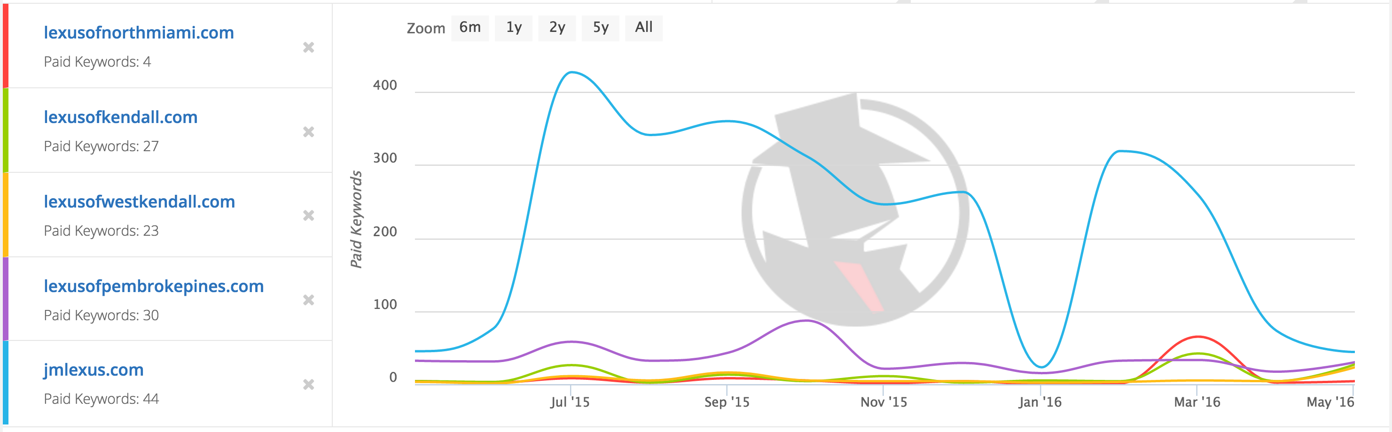
Here we see a breakdown of the keyword volume being used by each domain.

Slide 12
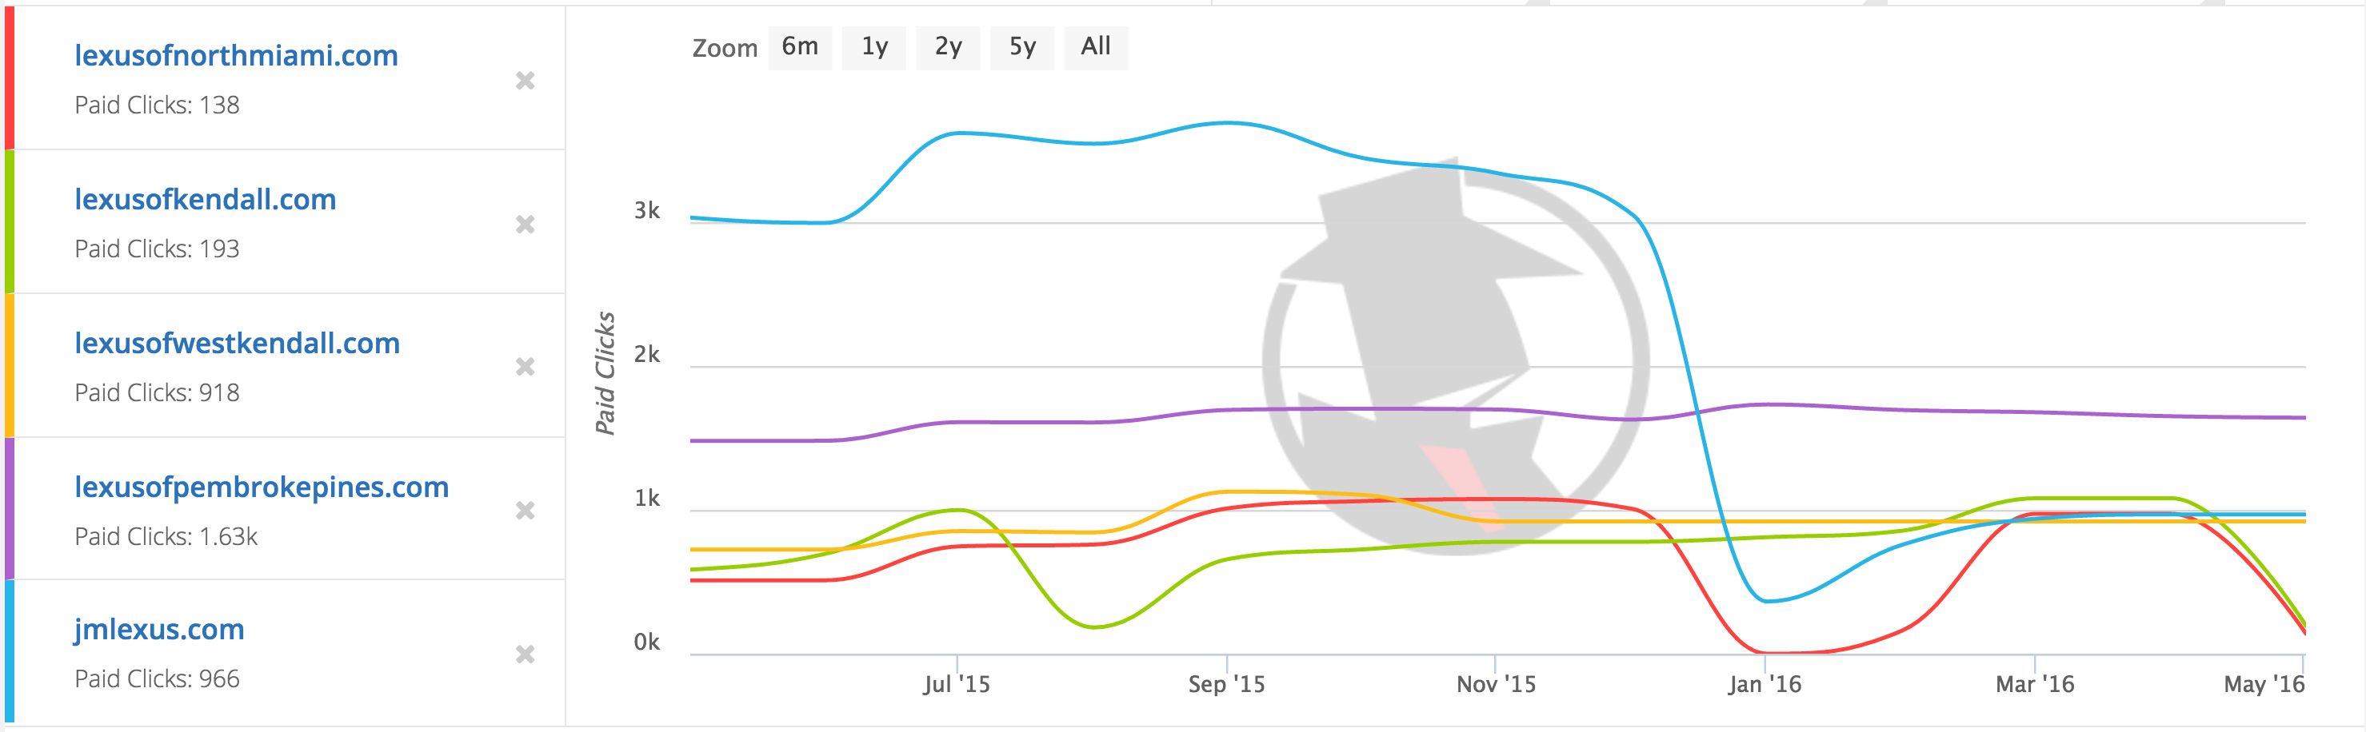
Here we see a breakdown of the click volume for each domain.

Slide 13
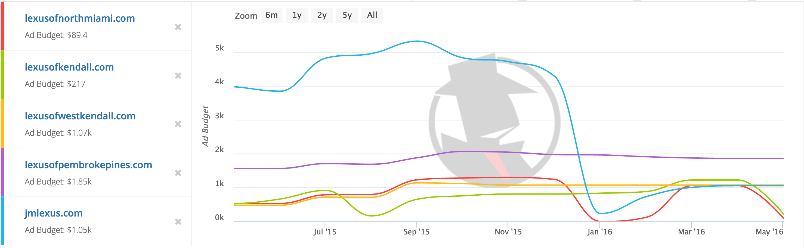
Here we see a breakdown of the advertising budget for each domain.
Let’s compare all 3 at once.

Slide 14
Here we get an incredible visual breakdown on keywords volume, click volume and advertising budget all stacked.
Key trends to note are that JM Lexus dropped their budget and limited themselves to a constrained list of keywords starting in late Dec, early Jan. Seems like they stopped promo for their Lexus December to remember promo?
Meanwhile, pembroke pines was consistent this entire year of data for all 3 categories shown.

Slide 15
What can you do with this data?
Let’s point out the areas of opportunity and growth for the new locations that you’re bringing under your operations umbrella, and existing successful locations like Prembroke pines and North Miami Beach.

Slide 16
Here we see a breakdown of the advertising budget for each domain.
This is a huge area for opportunity because if the current budget is lifted for North Miami Beach and the other locations you currently control over you’ll have immediate results.

Slide 17
Here we see a breakdown of the keyword volume being used by each domain.
This is the biggest area for improvement. I have an exact list of every keyword used for JM Lexus during their peak keyword usage.

Slide 18
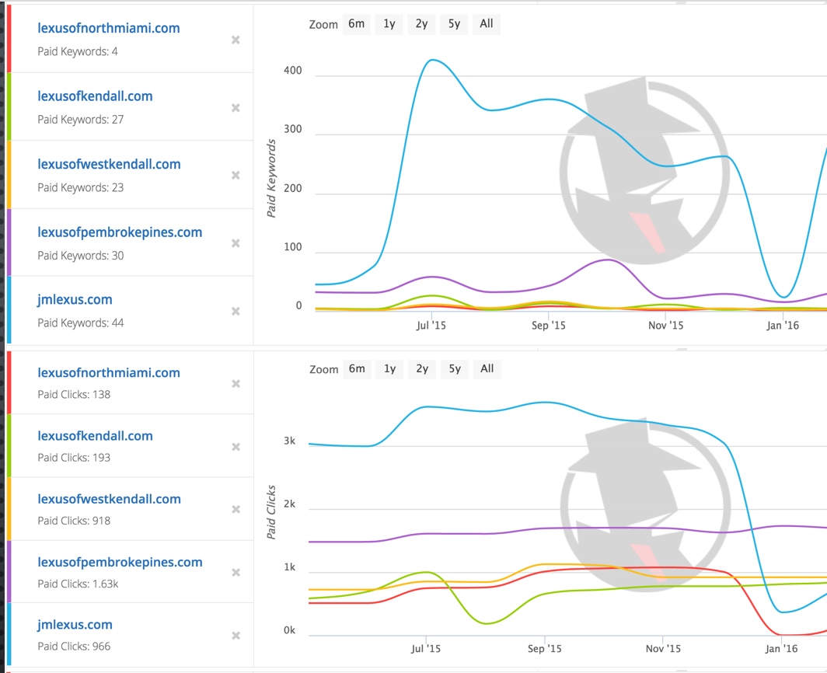
This is a huge area for growth when the keyword list is available with the click volume for each keyword because when added to any other Lexus location the keywords added all have a proven result.

Slide 19
The addition of that keyword list to both pembroke pines and north miami lexus locations in combination with a $4,000-$5,000 advertising would drive the same results JM Lexus once peaked at.

Slide 20
Action to take with these understandings
The execution plan is in place to add a proven list of keywords readily available to the PPC campaigns for both pembroke pines and north miami Lexus locations. This can be performed by the OK Group digital agency for a monthly retainer of $3,500.

Slide 21
The services that we'll include with Ad service:
1.) Dedicated Account Manager
2.) Account Review & Goal Setting
3.) Keyword Research
4.) Account Structure & Restructure
5.)Text Ad Creation & Optimization
6.) Dynamic Keyword Insertion
7.) Geotargeting
8.) Conversion Tracking
9.) Detailed Performance Reporting
10.) Unlimited Google PPC ad campaigns within the term optimized for conversions

Slide 22
When can this be done?
We can implement the keyword creation and ad creation with proven ads that have already worked for you and your competitors historically in under 7 working days for the $3,500 retainer cost.
What questions can I answer for you?

